Slide 1
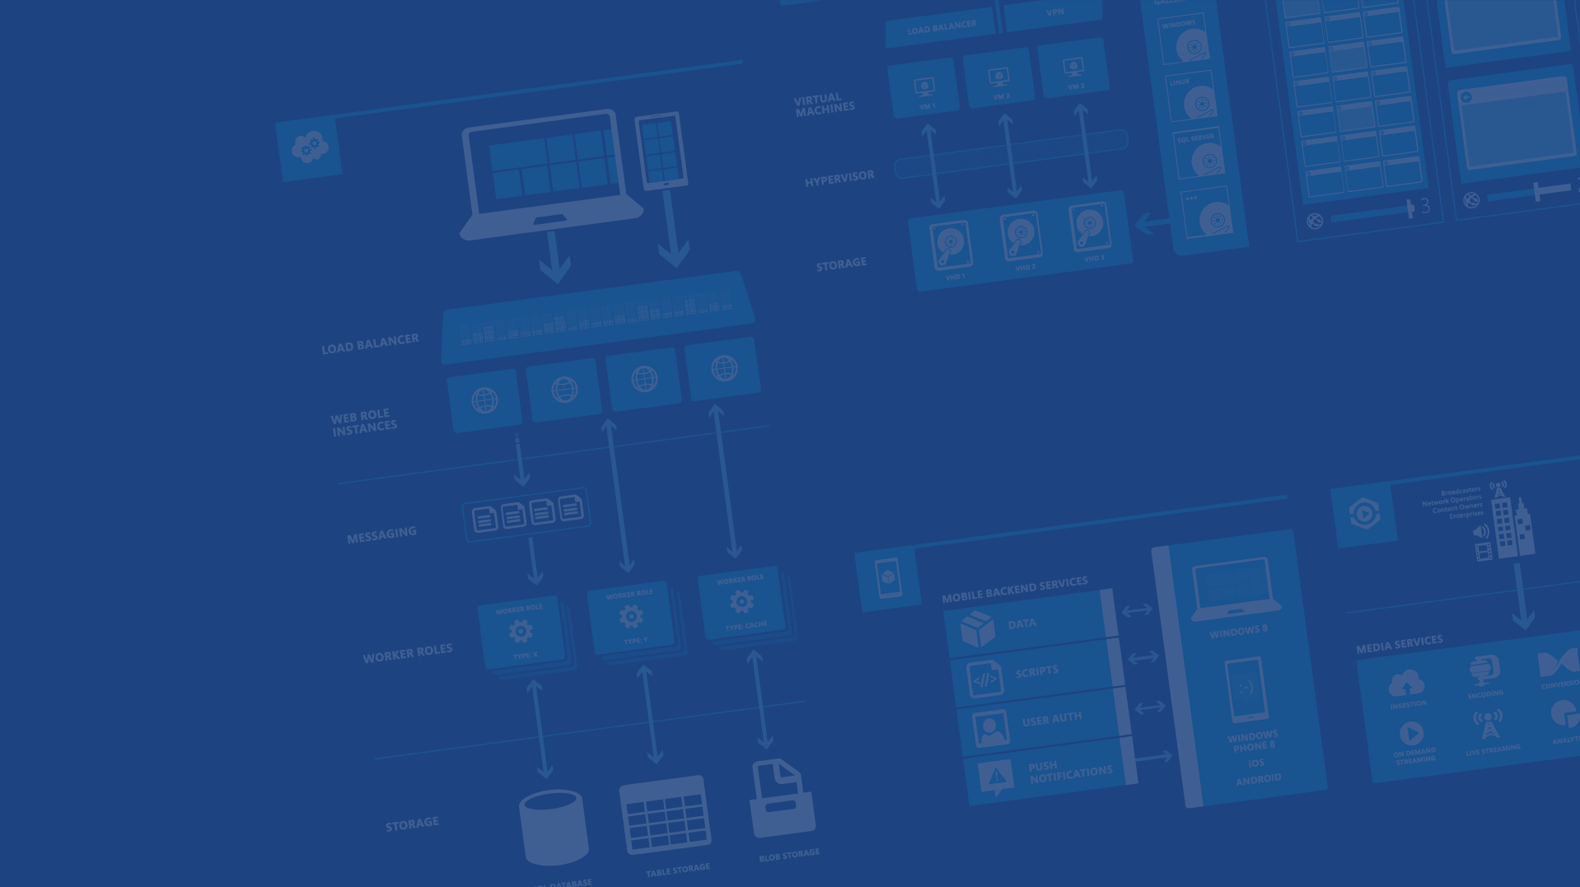
Foundation: Azure Virtual Machines, Cloud Services and Web Apps
Runeet Vashisht
Dev Lead, Microsoft
Email : runeetv@microsoft.com
Twitter : @runeetv
Session Content
http://1drv.ms/1KBQ34M

Slide 2
Agenda
Virtual Machines
Cloud Services
Web Apps
Language Support
Scale
Web Jobs
Notes:
Virtual Machines vs Cloud Services vs Web Apps
http://azure.microsoft.com/en-in/documentation/articles/choose-web-site-cloud-service-vm/

Slide 3
The three ways to host your applications on the Microsoft Azure Platform
Infrastructure as a Service
IaaS
Platform as a Service
PaaS
Notes:
Making the point that Virtual Machines is IaaS while both CloudServices and Web Apps are PaaS.

Slide 4
Azure Virtual Machine
Benefits:
All the benefits of on premise virtualization.
Quickly provision, scale, recover from hardware failure.
No upfront investment in hardware.
No ongoing investment in engineering competency.
Pre-configured images in Gallery.

Slide 5
Demo
Azure Virtual Machine

Slide 6
Azure Cloud Service
Benefits:
Create highly-available, infinitely-scalable applications and APIs.
Development experience powered by Visual Studio + Azure SDK.
Focus on building great applications.
Test your apps before deploying them.
Autoscale to optimize cost and performance.

Slide 7
Demo
Azure Cloud Service Creation

Slide 8
Azure Web Apps
Benefits:
High Availability with Auto-Patching
Built-in AutoScale and Load Balancing
Focus on building great applications.
.NET, Java, PHP, Node.js, Python
Continuous Deployment with Git, TFS, GitHub
WordPress, Umbraco, Joomla, Drupal

Slide 9
Hands on
Web App Creation
Scale
Web Jobs
Slots

Slide 10
Demo
Manual Scale
Auto Scale
Web Job

Slide 11
Web Jobs

Slide 12

WebJobs
Web App

Slide 13
Demo
Web Job

Slide 14
Deployment Slots

Slide 15
Staging
Web App

Slide 16
Staging
Web App

Slide 17
Staging
Web App

Slide 18
WebJobs
Web App

Slide 19
Demo
Deployment Slot

Slide 20
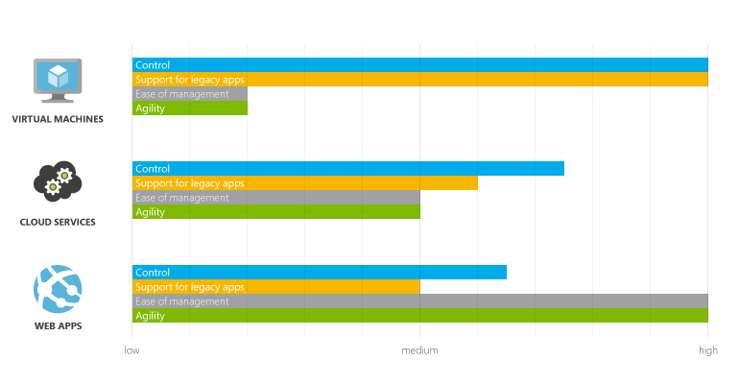
Comparison

Slide 21
Runeet Vashisht
Dev Lead, Microsoft.
Email : runeetv@microsoft.com
Twitter : @runeetv
Notes:
Virtual Machines vs Cloud Services vs Web Apps
https://azure.microsoft.com/en-in/documentation/articles/choose-web-site-cloud-service-vm/
Data Center
https://www.youtube.com/watch?v=JJ44hEr5DFE
https://www.youtube.com/watch?v=zXsoygN_v7A

